Slide 1
P4B Solar Mini-Grid: Socioeconomic Impact Analysis
CS 6150 – Computing for Good
Fall 2024

Slide 2
Current Project
Education
Data Cleaning and Preprocessing:
Implement feature engineering to convert the post survey data into binary variables and ordinal variables.
Leveraging factor analysis to reduce the number of variables to get a more concise dataset.
Key Metrics:
Primary indicators for analysis: children_school_performance_change, which indicates if children get school performance improved.
Key insights:
Key indicators from the analysis—such as Home Exterior Lighting, Recent Business Activity and Changes in Household Headcount—illustrate factors within the household environment that significantly influence educational performance. Economic stability (business activity), home security (exterior lighting), and household stability (headcount) all contribute meaningfully to children's educational outcomes.
This demonstrates that the Mini-Grid project impacts educational performance not only by providing a stable energy supply and reliable lighting access enabling extended study hours, but also enhances the overall living environment, fosters economic stability, and creates job opportunities to improving the broader socioeconomic environment.
Notes:
How have we accomplished deliverable's critical functions
Explain the process of analyzing the data and a summary of the insights we have obtained so far

Slide 3
Current Project
Healthcare
Data Cleaning and Preprocessing: Handled missing values and normalized formats for consistent pre- and post-survey dataset comparisons
Key Metrics:
Primary indicators for analysis: Clinic Travel Distance, Electricity Access, Operational Hours, Refrigeration Access
Key insights: Significant healthcare improvements with solar mini-grid implementation
Enhanced Electricity Access
Extended Operational Hours
Reduced Travel Distance
Notes:
How have we accomplished deliverable's critical functions
Explain the process of analyzing the data and a summary of the insights we have obtained so far

Slide 4
Partner Engagement
First meeting: September 19th
Renewvia is a company that helps construct powerlines and solar mini-grids to help provide electricity to rural communities in Africa. A study was conducted to understand the socioeconomic impact of mini-grids on these rural communities. Surveys were administered a year apart: before being connected to a mini-grid and a year after being connected to a mini-grid.
Dr. Selby provided us the related paper and CSV data aggregated from the study. He did not provide any specifics of a deliverable or what data he wishes gleaned from the study data. It was left up to the team to determine what topics or subgroups the team should deep dive into.
Initial Prototype Evaluation: October 7th
Dr. Selby evaluated the initial analysis conducted on the healthcare and education subgroups. He deemed our analysis good and to continue researching.

Slide 5
Partner Engagement
Second meeting: October 16th We presented the current descriptive analysis and preliminary machine learning model results which show that solar mini-grid help the development in education and healthcare in local communities. Dr. Selby shared the following feedback:
Continuing deep diving into the relationships among the variables. Try to locate any unseen correlation between education/healthcare variables and other features.
Select one subject to continue analyzing (education or healthcare)
Select at least one journal with a relevant subject matter that accepts short-form research papers and try to apply to publish the analysis result by the end of the semester.

Slide 6
Partner Engagement
Third meeting: October 30th:
We presented an in-depth analysis and enhanced machine learning model results, identifying key factors through which solar mini-grids positively impact the socioeconomic environment and contribute to educational development in local communities. Dr. Selby provided the following feedback:
We discussed project deliverables, agreeing on a letter that could potentially be published in journals such as ACS Energy Letters or IET Electronics Letters.
To improve the current analysis, Dr. Selby suggested using an ordinal variable as the dependent variable to reduce directional bias caused by numerical values.
He also encouraged us to further explore the relationship between education and household headcount.

Slide 7
Future Direction
In our October 30th meeting with Dr. Selby, he suggested that we create an outline for the letter's structure.
Dr. Selby recommended converting children_school_performance_change from a binary variable to an ordinal variable to minimize directional bias caused by numerical values and to observe its impact on the analysis results.
He also observed a negative correlation between household_headcount and children_school_performance_change in our analysis and expressed interest in exploring the underlying reasons for this outcome.

Slide 8
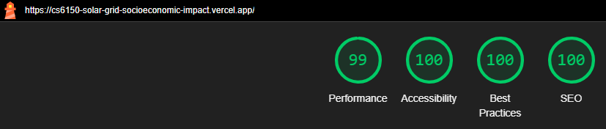
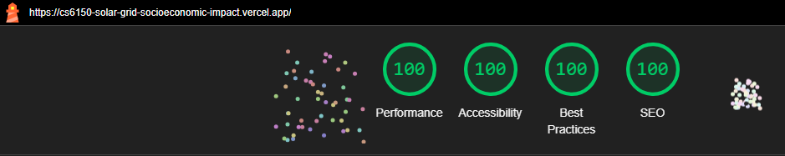
Project Website – Lighthouse Metrics
Mobile
Desktop

